Slide 1
CSCI 7000
Intro to Enterprise Networks
LAN Switching Basics
Jose R. Santos
Network Engineering @ Computer Science

Slide 2
Lab 0
Introduction to lab tools
    Learn the basics of LAN cabling
    Learn how to connect a Personal Computer to a Cisco Router/Switch for configuration.
    Learn basic configuration commands used on Cisco Equipment, including user levels.
    Learn how to connect to a router remotely via Telnet.
    Learn how to configure a Comm Server.

Slide 3
Cabling
Interference
  Shielding & Spacing (Electromagnetic Interference)
  Spectrum allocation
  Temperature (Higher Temperature increases attenuation 60°C 10% more than 40°C)
  Shield must be grounded (Drain Wires)
Bandwidth and data rate
  Ethernet 10Base-T Manchester 7.5 Mhz
  Ethernet 100Base-T 4B5B/MLT-3 31.25 Mhz
  Ethernet 100Base-T4 8B6T 12.5 Mhz
  Ethernet 1000Base-T 8B/1Q4 PAM5 125 Mhz
  1G-10G CAT 6 ( 250Mhz ) CAT 6e (600Mhz)
Trade offs
  Rate / twisting / attenuation

Slide 4
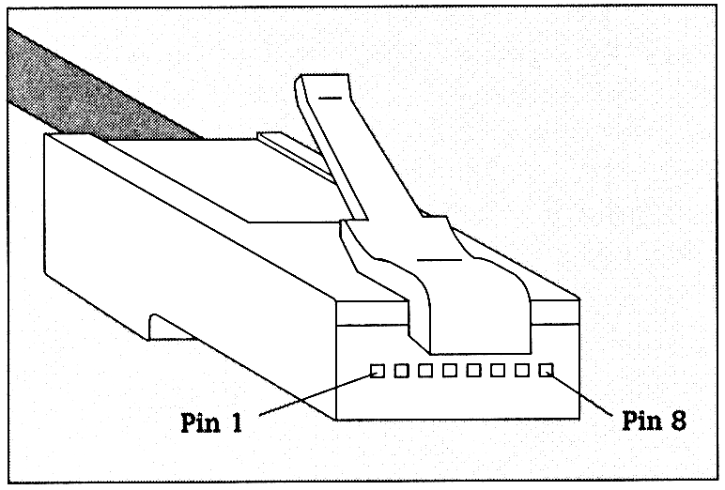
RJ 45 connector
-Straight through (1,2 TX 3,6 RX)
-Crossover (1,2 -> 3,6)
-Research pinout for 1000BaseT (Include on Lab 1 Report)

Slide 5
Cabling Terms to Remember
CrossTalk
  The unwanted coupling of the signal from an adjacent pair of conductors onto the subject pair at the transmit end. A familiar example of cross talk in general is when you hear a second conversation on the telephone while you are talking.
  Crosstalk is reduced by the twisting of the copper pairs.
Plenum
  In some buildings, the entire space above the drop ceiling is used as a return air pathway instead of a set of ducts. Therefore air circulated within that space gets distributed through out the floor, or the building.
  If a cable located in an open air plenum has a PVC jacket and catches fire, the toxic fumes would spread throughout the entire floor via the open plenum, thereby suffocating or at least impairing people's ability to get out of the building. To overcome this, some cables are coated with teflon to prevent the spread of flame and toxic fumes.
  Source: http://cablingdb.com

Slide 6
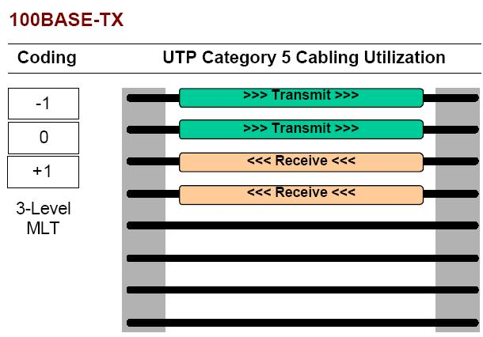
Ethernet
Source: http://docs.hp.com/en/784/copper_final.pdf

Slide 7
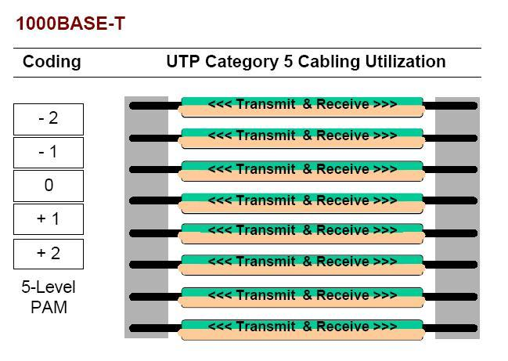
Gigabit Ethernet
Source: http://docs.hp.com/en/784/copper_final.pdf
Good Slide deck: https://montcs.bloomu.edu/Presentations/275/Gigabit-crossover-cable.pdf

Slide 8
Cable Test
Wire Map
  Continuity
  Shorts
  Reversed pairs (1-2, 2-1)
  Split pairs (1-2 1-3)
  Transposed pairs (1-2 4-5)
Length
  Electrical (considers Twisting)
  Physical
Attenuation (Insertion Loss)
  Patch Cord + Connectors+ Cable Length

Slide 9
Cable Test
NEXT/FEXT (Near End / Far End)
  Strength of unwanted signal coupling from one pair to another (Compares all pairs)
PSNEXT (Power sum NEXT) Cat 5e +
  combined cross talk from all near end pairs operating simultaneously.
  As an example if we wanted to know what the PSNEXT was on pair 1, pair 1 would remain non energized while pairs 2, 3 and 4 became energized
ELFEXT Cat 5 +
  dB difference between FEXT & Insertion loss
PSELFEXT (Power sum ELFEXT) Cat 5e +
Delay and Delay Skew Cat5 +
Return Loss-for Cat 5 +
  Signal reflections caused by impedance mismatches between Cable and Connectors
Source: http://cablingdb.com/Training.asp

Slide 10
Layer 1 Matters!
Optical
  Type of laser and wavelenght
    SX (33-300m)
    LX/LH (10km – 40km)
    ZX (70km – 100km)
  Type of fiber
    SM
    MM

Slide 11
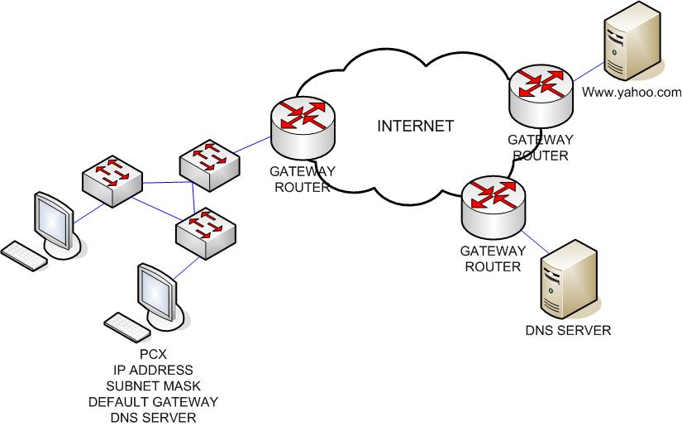
Network Process
Ping from PCX to www.yahoo.com

Slide 12
Why Bridging / Switching ?
10Base2 / 10Base5: Single electrical bus
  Collisions
  1TX at a time
  Broadcast to all devices
  Scalability
10BaseT: Introduced Transparent bridges
  Improved availability
  Reduced number of Collisions by increasing the number of collision domains
  Added bandwidth 10Mbps for all vs. 10Mbps for each few

Slide 13
Transparent bridging
Transparent: endpoints don’t need to know about a bridge’s existence
MAC Review: Unicast / Broadcast / Multicast
Bridge actions
  Forward vs. Filter: forward if necessary; use bridge table
  Learn MAC Addresses, build bridge table: check source MAC on receiving frame, if not found in table add it. Record both MAC and port received
  Forward Unknown Unicast/Broadcast: no match? forward.
  Maintain a loop-free environment: Run Spanning-Tree-Protocol
Remember that bridges never forward traffic on the same interface it came in

Slide 14

Operation of a switch

Slide 15
LAN Switching
Bridges vs. Switches
  Similar behavior in forwarding, learning and loop protection
  Switches have more port density / faster processing
  FDX Ethernet: 1 device/port, no collisions possible, disable NIC loopback, TX and RX at the same time
  Internal Processing Variations:
    store and forward (transparent bridging): receive entire frame, check FCS, then TX
    cut-through: received destination MAC then start TX, less latency, but forwards errors
    fragment free: wait for 64 bytes of a frame, if no collisions then forward
  Speed and Autonegotiation: Default to 10Mbps HDX
Most popular!

Slide 16
LAN Segmentation
Collision Domain (Eth. Segment): set of LAN interfaces that could collide with each other while TX
  switch & router splits LANs into collision domains
Broadcast domain: Where L2 broadcasts can be forwarded when 1 node TX
  switch & bridge forward broadcasts
  router splits broadcast domains
Benefits table (p248)

Slide 17
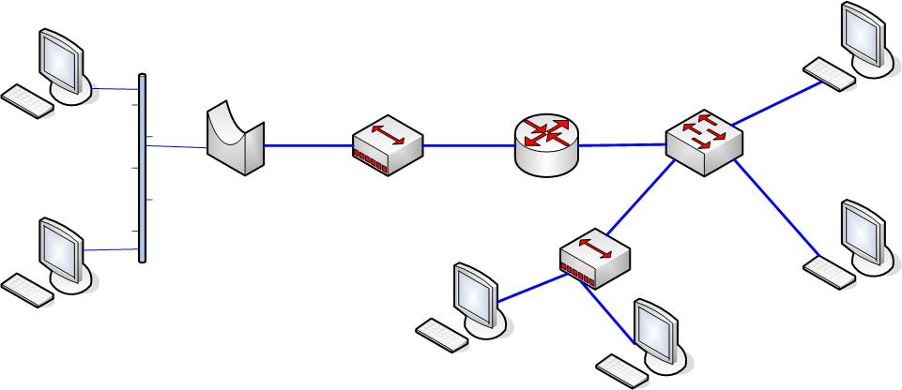
LAN Segmentation
Collision Domain vs. Broadcast Domain

Slide 18
Spanning Tree Protocol (802.1d)

Slide 19
Spanning Tree Protocol (STP)
LAN redundancy: fail proof
How loops can happen (draw)
  unknown unicast addresses
  broadcast frames
STP goal:
  Create a single currently active logical path between each pair of LAN segments, by blocking some interfaces
  Blocking: Interface cannot forward or receive frames
  Forwarding: Interface can send and receive frames

Slide 20
Spanning Tree Protocol
L2 Broadcast
Resiliency/Availability
Loop Prevention
Root Bridge
  Lowest Bridge ID
  Cost to Bridge (root port)
  Designated Port (SW with lower cost to Bridge)
Ports
  Blocking State
    Listening
    Learning
  Forwarding State

Slide 21
Spanning Tree Protocol (STP)
STP Algorithm
  Bridge Protocol Data Units (BPDU’s): “hello” messages exchanged by all devices, all claiming being the “root bridge”
  SW with lowest ID is elected root: 2 byte priority + 6 byte MAC
  All ports in root bridge change to Forwarding state
  Root bridge TX “hello” continuously, cost field in hello’s is incremented by non-root switches
  non-root switches pick better path to root bridge, port with lowest cost becomes root port

Slide 22
Spanning Tree Protocol (STP)
STP Algorithm (Cont..)
  Designated bridge: On each LAN with more than 1 switch on the same segment the switch with the lowest administrative cost to the root bridge is the “designated bridge” for that segment, the interface used to connect to the segment is called “designated port”
  Designated ports are set into Forwarding state
  All other ports are set into Blocking state*
  * NOTE: Ports in Blocking state still listen for BPDU’s but take no action

Slide 23
Root Election Review
“Hello” BPDU
    Bridge ID: priority and MAC
    Cost to reach the root: link speed. Starts at 0
    Lower speed, higher cost
    Bridge ID: BPDU sender
Lowest priority becomes the root
If a bridge hears of a better candidate:
    Stops advertising as a root
    Starts forwarding the hello of the better bridge
Root port:
    Port that RX least cost BPDU from Root SW

Slide 24
STP and Link Failure
STP topology does not change unless there is a topology change
Root bridge TX “hellos” every 2 sec
Rest of bridges forward with added cost
Everybody gets BPDU’s
Timers
    Hello Time: 2 sec
    Max Age: 20 sec. wait period for BPDU w/o action
    Forward Delay: 15 sec, used in Listening and Learning Transitions

Slide 25
STP and Link Failure
Max Age timer passed
  Re-TX as root
  Use next best claim of root
Am I receiving hello with lower BridgeID on another port?
  If so move port from blocking to forwarding state
Flush MAC address table
  Network reachability is different via this point
Tell other switches about changes
  Topology Change Notification (TCN BPDU)
  RX switch timeouts MAC table after Max Age timer (20 sec) + forwards TCN to other switches.

Slide 26
From Blocking to Forwarding
STP uses 2 intermediate interface states
  Listening:
    Make sure you don’t get better BPDU’s from other SW. Listen for BPDU’s, don’t learn nor forward (15 s). TX TCN BPDU to other switches
  Learning:
    Learn MAC’s but don’t create loops. Listen for BPDU’s, learn, but don’t forward (15 s)
Other port state: Disabled: Administratively down (shut)
Blocking
Listening
Learning
Forwarding
50 seconds

Slide 27
Optional STP features
EtherChannel
  Prevent need for STP convergence, save time
  Combine 2-8 parallel trunks between 2 switches
  STP treats them as a single link. If at least 1 link is up to convergence is needed
  All parallel links work at the same time = more bandwidth
  If no EtherChannel is running, STP will block all but 1 port!
PortFast
  Enables forwarding on ports as soon as they are activated
  Appropriate for connections for end-user devices, not for ports connected to other switches or STP enable devices
  If disabled forwarding happens after 50 sec.

Slide 28
Next Week
Topic VLAN, Wireless LAN’s
Check Syllabus for reading Materials
More reading on Ethernet:
    http://www.cisco.com/c/en/us/tech/lan-switching/ethernet/index.html
    http://docwiki.cisco.com/wiki/Ethernet_Technologies

